Slide 1

BlueTool Install and Test Command

Slide 2
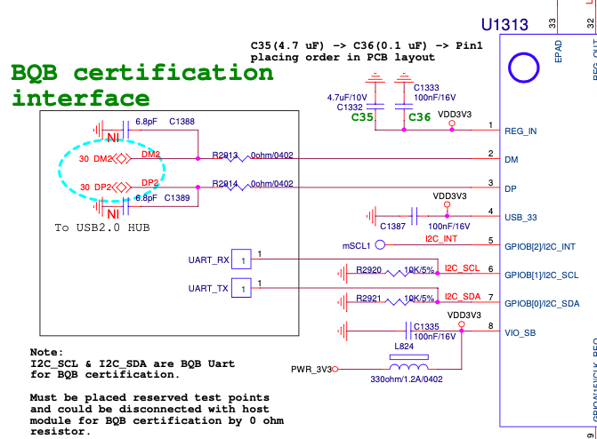
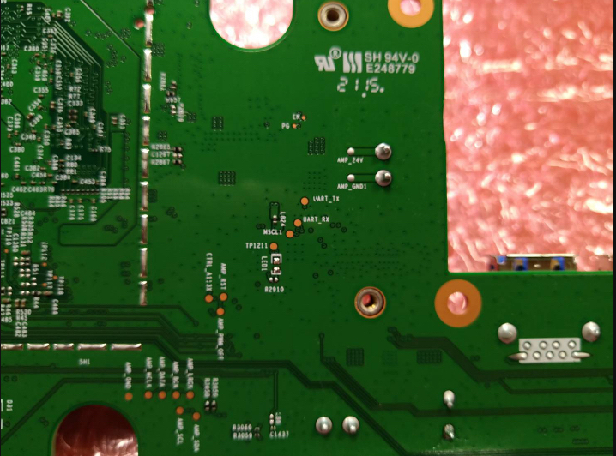
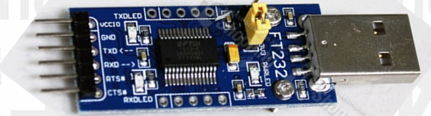
HW Rework:
Main board connects to Console board
UART_Tx→TXD
UART_Rx→RXD
Ground→GND
Ground
UART_Tx
Schematic
UART_Rx
Console board
Bottom side of Main board

Slide 3
NOTE
If display error message, need to
(1) DUT Reset (power off and then power on again)
(2) Re-plug in USB to TTL dongle
(3) Close BlueTool and open tool again

Slide 4


A. Install BlueTool
Open Bluetool folder → Install ActivePerl-5.8.4.810-MSWin32-x86
Install BlueTool

Slide 5
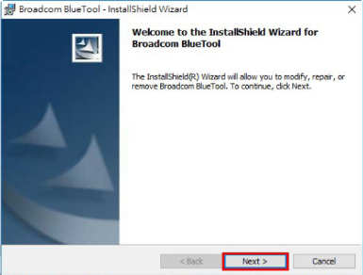
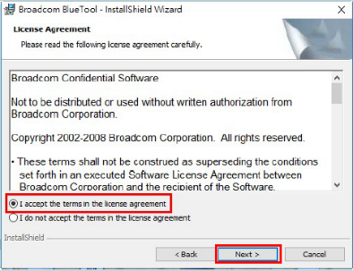
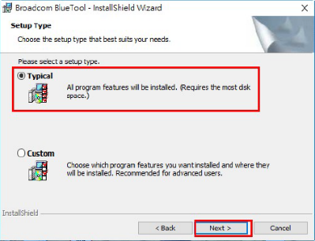
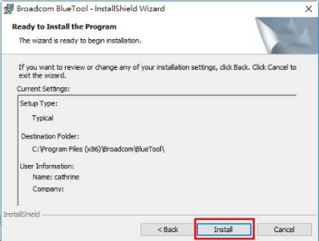
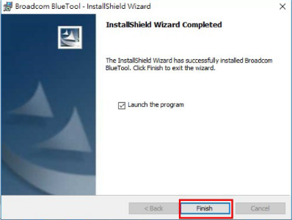
1

Slide 6
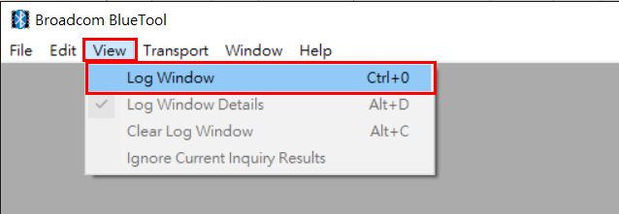
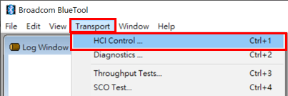
B. Enable Test Mode
NOTE
Page 7-9 must to complete within 30 second
DUT Power on, plug in USB within 5 second
2. Open BlueTool
3. From the View menu, select Log Window
4. From the Transport menu, select HCI Control

Slide 7
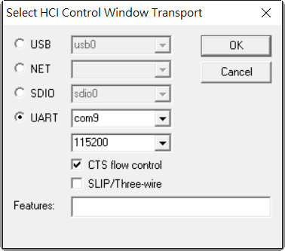
5. (1) In Select HCI Control Window Transport, select UART
(2) Key-in COM PORT, the same with device manager
(3) Select baud rate to 115200
(4) Cancel CTS flow control
(5) Click OK
(5)
(1)
(2)
(3)
(4)

Slide 8
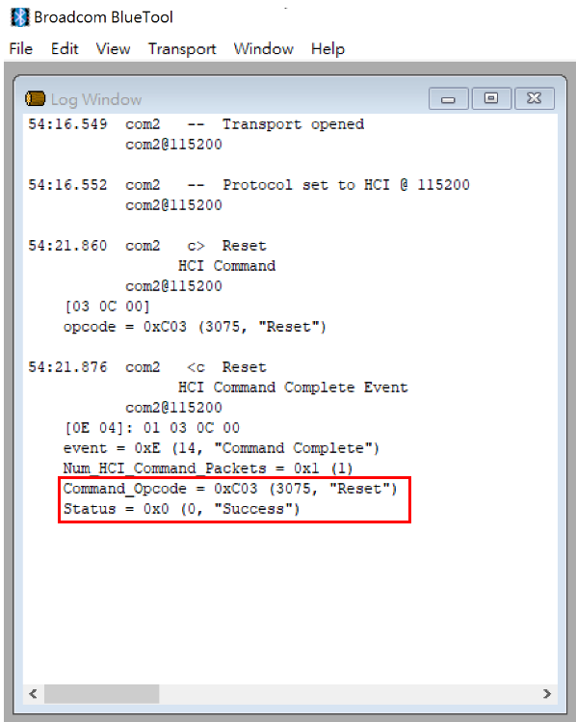
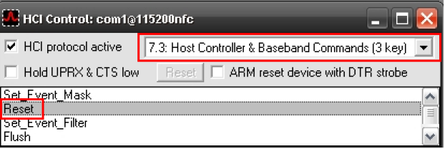
Reset
6. In the HCI Control Command Window
  Select 7.3 Host Controller & Baseband Command
  In the main body of the window, double-click Reset
  (3-1) Deliver first reset within 30 sec at DUT power on
  (3-2) wait to success message at the last line reads status = 0x0 (0, "Success")
(1)
(2)
(3-1)
Deliver first reset within 30 sec at DUT power on
(3-2)

Slide 9
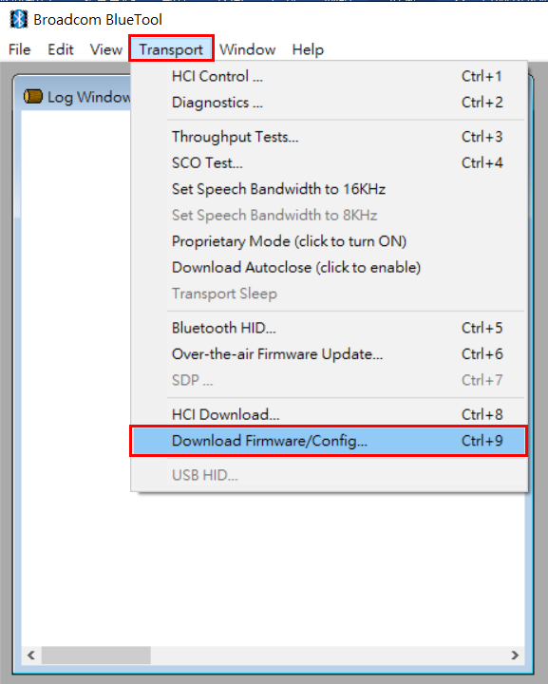
Download Firmware
7. Download Firmware
  From the Transport menu, select Download Firmware
(1)

Slide 10
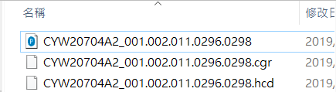
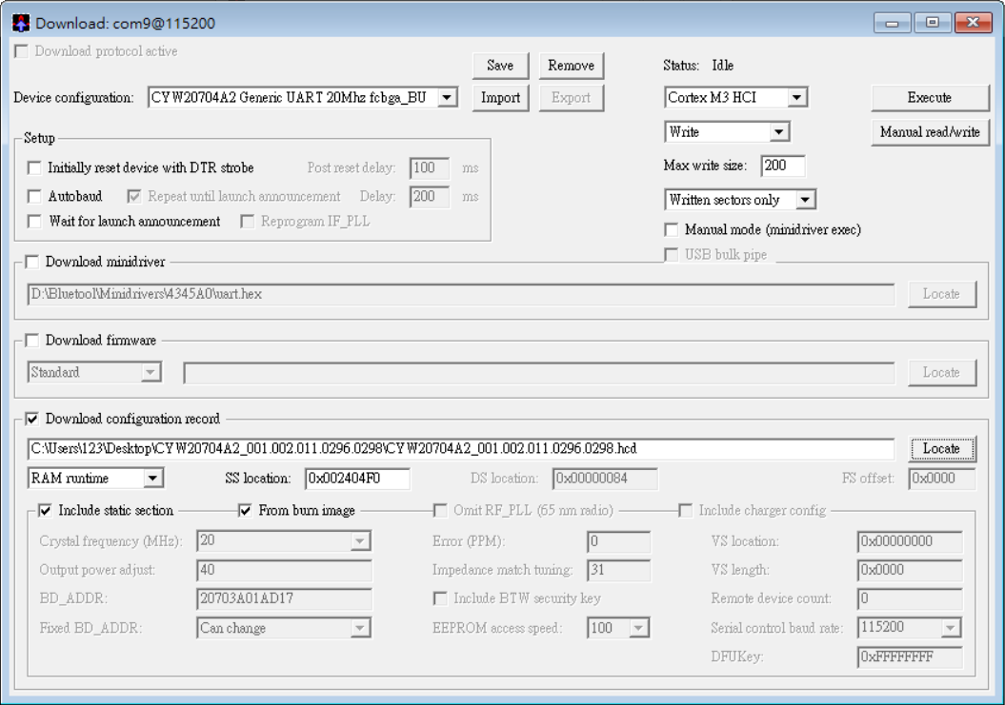
  Import → Select CYW20704A2_001.002.011.0296.0298
(7)
(2)
(3)
Cancel
(4)
Cancel
(6)
Select download configuration record → Locate → Select CYW20704A2_001.002.011.0296.0298.hcd
(5)
Select from burn image

Slide 11
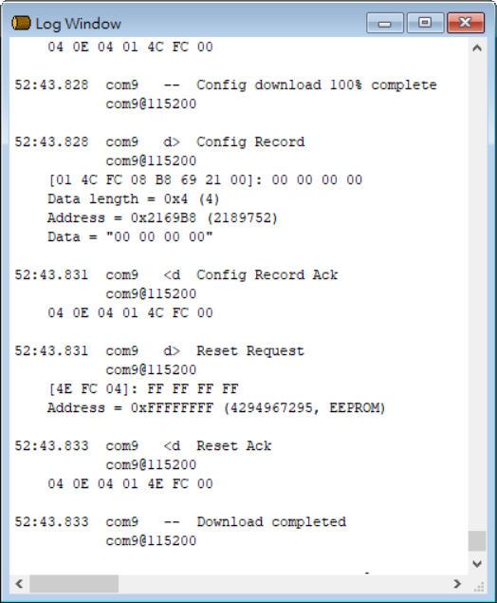
  Display Download completed and next step

Slide 12
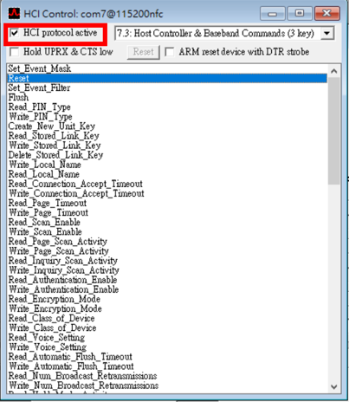
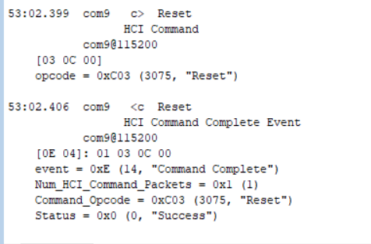
Reset
8. (1) After Load FW → select HCI control window → select HCI protocol active
(2) Click Reset
(3) In the log window, the last line reads status = 0x0 (0, "Success")
(1)
(2)
(3)

Slide 13
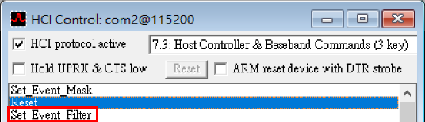
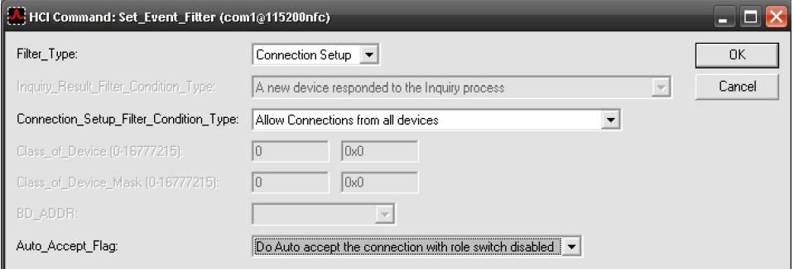
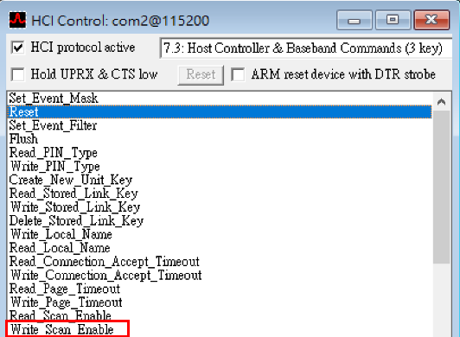
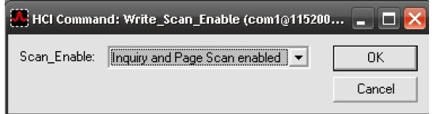
9. Set Event Filter
Success : In the log window, the last line reads status = 0x0 (0, "Success")
Connection setup
Allow connection from devices
10. Write Scan Enable
  Success : In the log window, the last line reads status = 0x0 (0, "Success")
Do auto accept the connection with role switch disable
Inquiry and page scan enable

Slide 14
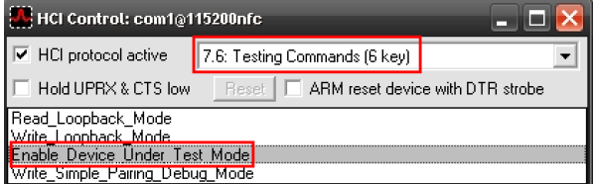
11. Enable Test Mode
Success : In the log window, the last line reads status = 0x0 (0, "Success")

Slide 15
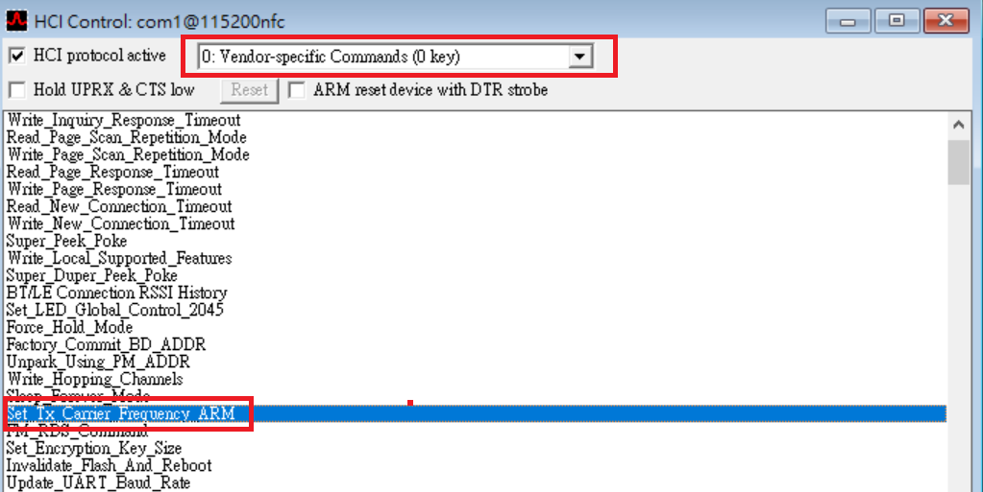
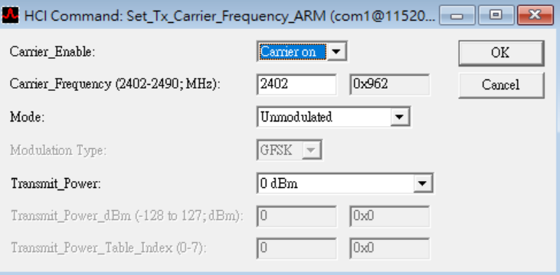
C. Set Tx Carrier Frequency ARM

